Slide 1
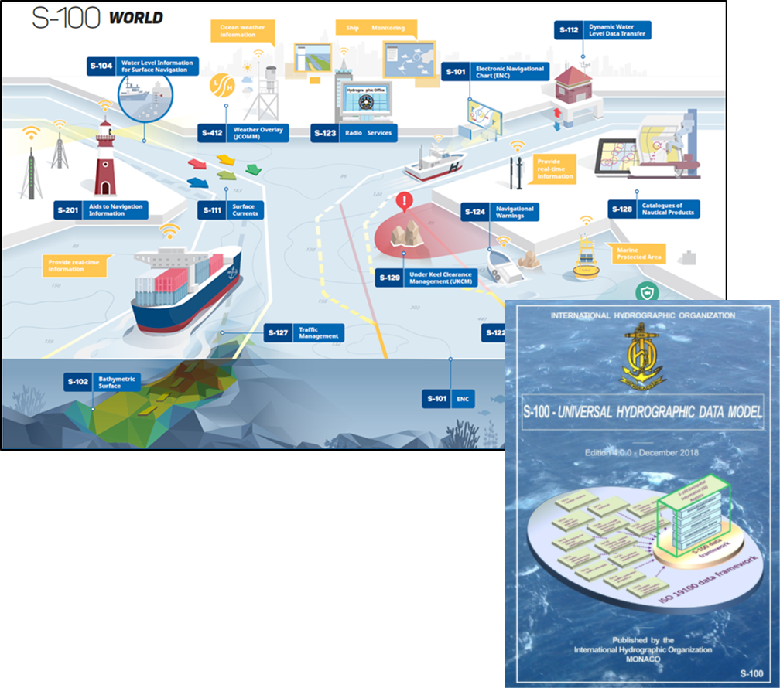
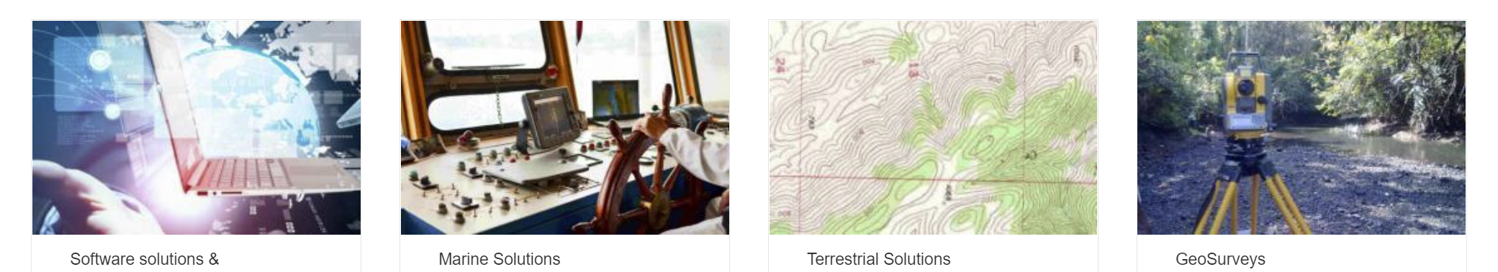

IIC Technologies
IIC Technologies provides solutions and services for the acquisition, management, integration and dissemination of geospatial data.
Global Presence – Clients in over 30 countries
End-to-end geospatial solutions to the Aeronautics, Defense, Government, Infrastructure, Marine, Oil & Gas, Transportation and Utility sectors.
Marine Sector.
Production of Marine Charts and publications data for Navigation
Consultants on international standards for hydrography with over 25 years experience in pioneering digital navigation
Senior Consultants specializing in modelling, development, data production and cross-sectoral integration.
Notes:
Our Senior consultant for the testbed project is Jonathan Pritchard. Jonathan has over 20 years experience in the geospatial industries and over 30 years experience in the technology sector. Via cryptography and the telecommunication industry, Jonathan joined IIC Technologies from the United Kingdom Hydrographic Office, one of the foremost marine geospatial mapping agency in the world. He has over 20 years experience within geospatial standards working groups in the International Hydrographic Organization and is one of the current founding co-chairs of the OGC’s Marine Domain Working Group. He carries out development and consulting work in a wide variety of fields concerning marine geospatial data across the IHO, ISO and Un-GGIM groups. He was technical lead for the OGC’s Maritime Limits and boundaries Pilot Project, where the foundations of integration between the IHO’s S-100 framework and OGC web services were laid.

Slide 2
“Using the IHO’s S-100 framework as a representation of data content and modelling, execute an OGC API reference implementation of S-100 metadata and S-128 content for advanced dataset discovery”
The objectives of the research are:
Demonstrate how IHO S-100 marine data can be discovered using existing OGC API Records methodologies and the ISO 19115 metadata embedded in S-100 datasets and service discovery metadata within ISO S-128.
Setup a testbed for a region with multiple S-100 datasets and service definitions in S-128 and provide dataset discoverability services using OGC API methodologies.
Feedback to the OGC community, primarily through OGC MDWG, and IHO and through the upcoming revision to S-100 (edition 5.0.0) on any modifications to the standards base to more easily enable interoperability between the two frameworks.
Produce a documented initial approach detailing how the discoverability elements can be used as a prototype to develop full OGC/IHO interoperability and the potential for such interoperability.

Slide 3
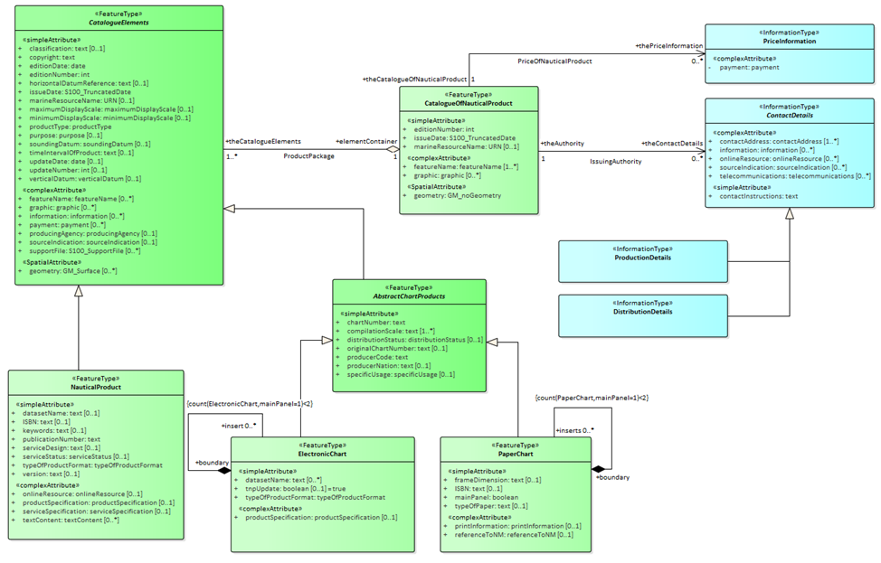
Some Background
IHO S-100 is a core standard for marine geospatial data in multiple domains and sectors.
Provides a framework for expressing arbitrary marine phenomena using a set of “product specifications”. These are composed of:
Formal model (UML)
Feature Catalogue (XML)
Encoding (currently GML, ISO8211 or HDF5)
Metadata is ISO19115 conformant (XML, with some mods)
IHO S-128 is a product specification which models common elements of metadata describing “services” and is used, primarily for service discovery. Specific to Maritime Data Services. Use Cases for ECDIS only
No formalised IHO->OGC mapping exists today, let alone at a framework (meta) or metadata level.
This project will deliver an S-128/S-100 metadata instance and make significant inroads into the generalised case
That’s the plan…. ☺

Slide 4
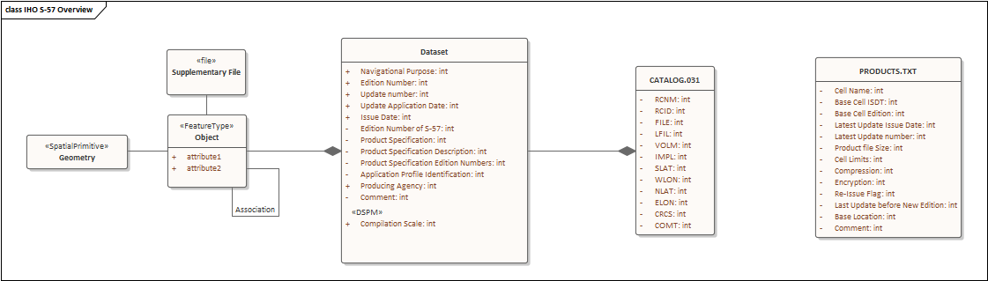
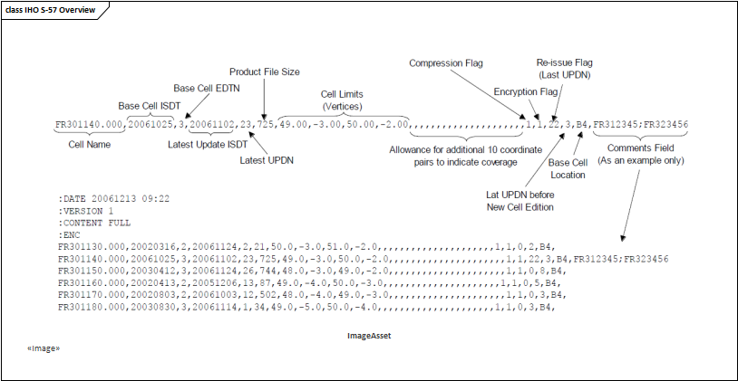
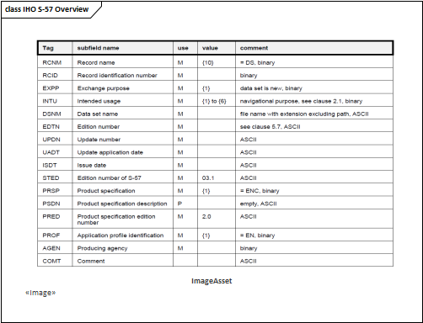
IHO S-100, the replacement for S-57. Edition 5.0.0 in preparation
Not yet approved for Navigation under SOLAS. In Development. Will replace data for Navigational Charts and Nautical Publications.
Multi-format, Vector, Gridded (HDF5), GML
Multi-Product (S-101, S-102, S-104, S-111 etc etc…)
Products have rigorous XML catalogues describing their content. IHO registry defines concepts
Data is “features” with “attributes” and “sub-attributes” aggregated into datasets, then into exchange sets and into a service.
Metadata
Cell Metadata – varies depending on encoding
CATALOG.XML ISO19115 conformant Exchange Set metadata
S-128 – Service metadata. “Catalogue of Catalogues”
IHO S-57 established since 2001
Data for existing Navigational Charts, ISO8211 format
“Objects” with “attributes” aggregated into cells, then into exchange sets and into a service.
Metadata
Cell Metadata DSID/DSPM records
CATALOG.031 Exchange Set metadata
PRODUCTS.TXT – Service data.
OGC API Records
Availability.

Slide 5
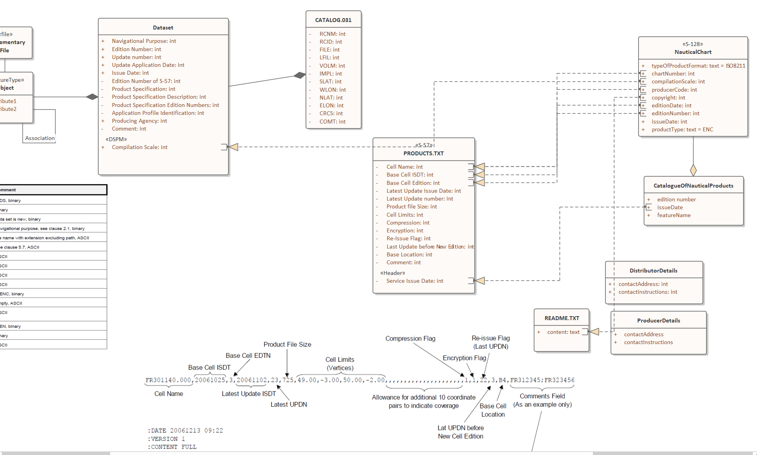
Ongoing Element Mapping:
S-57 to S-128 (Catalogue of Catalogues)
S-100 CATALOG.XML to S-128
IHO S-128 -> OGC API
CATALOG.XML (ISO19115) -> OGC API
Geometry Extraction (BBOX and COVR)

Slide 6
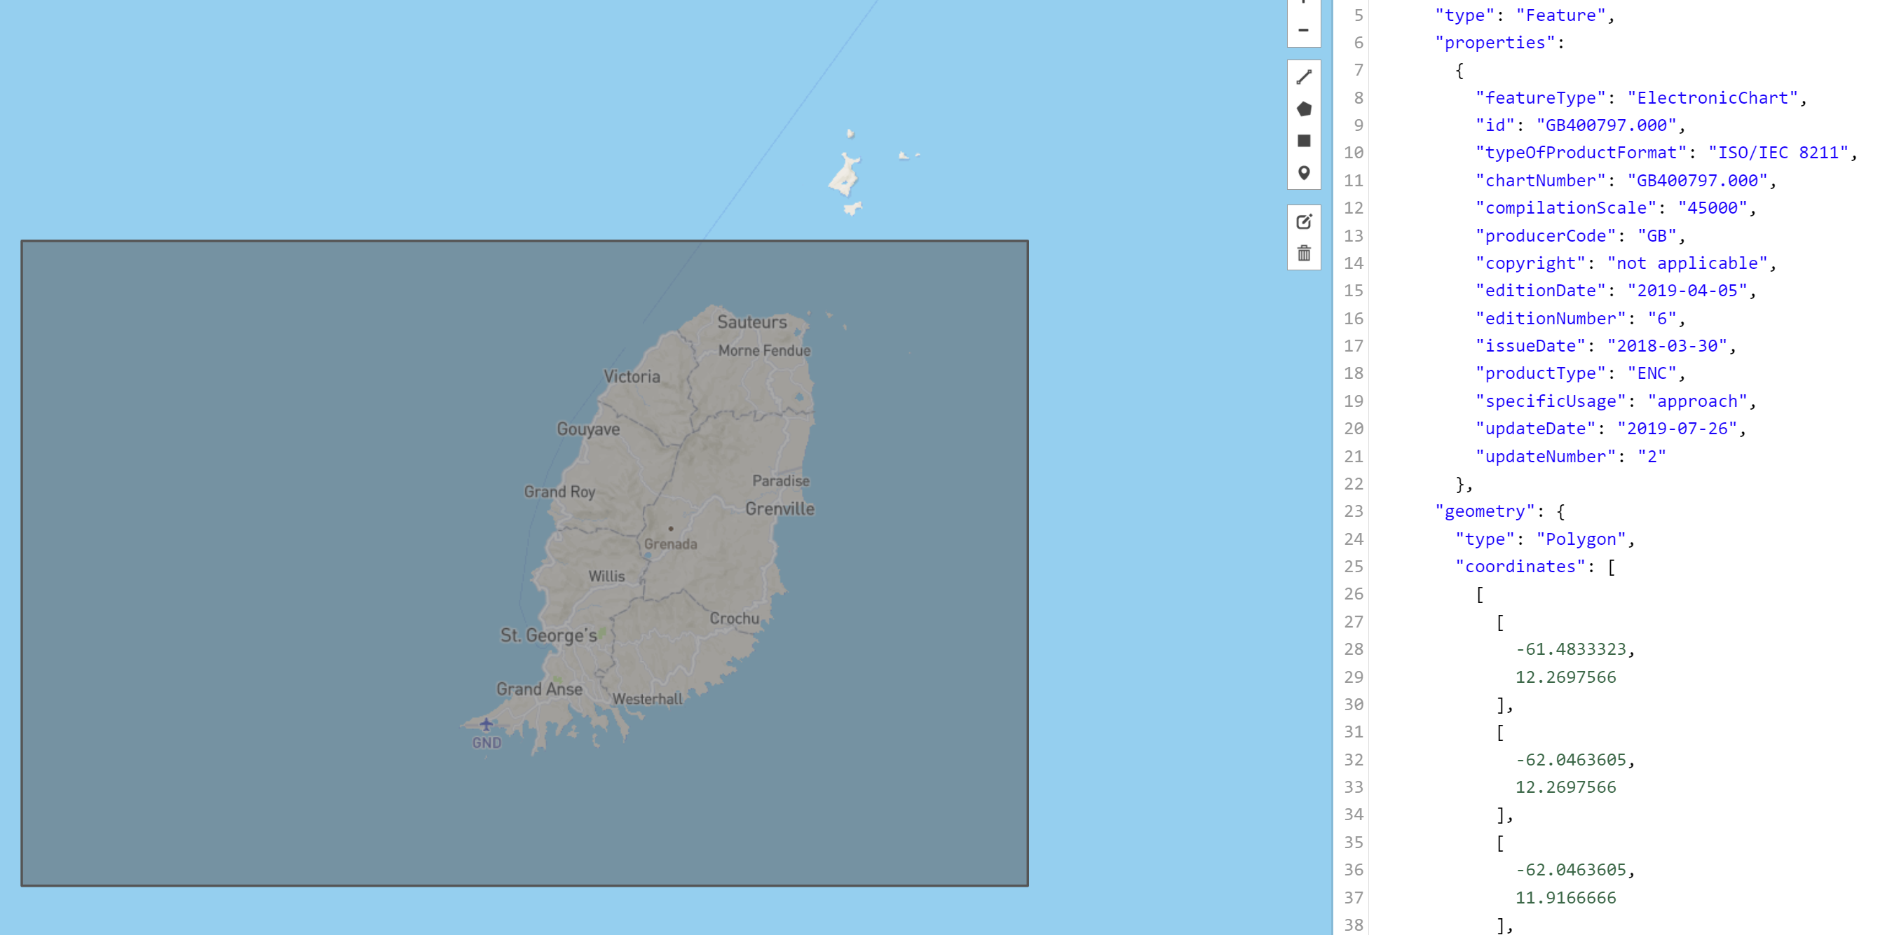
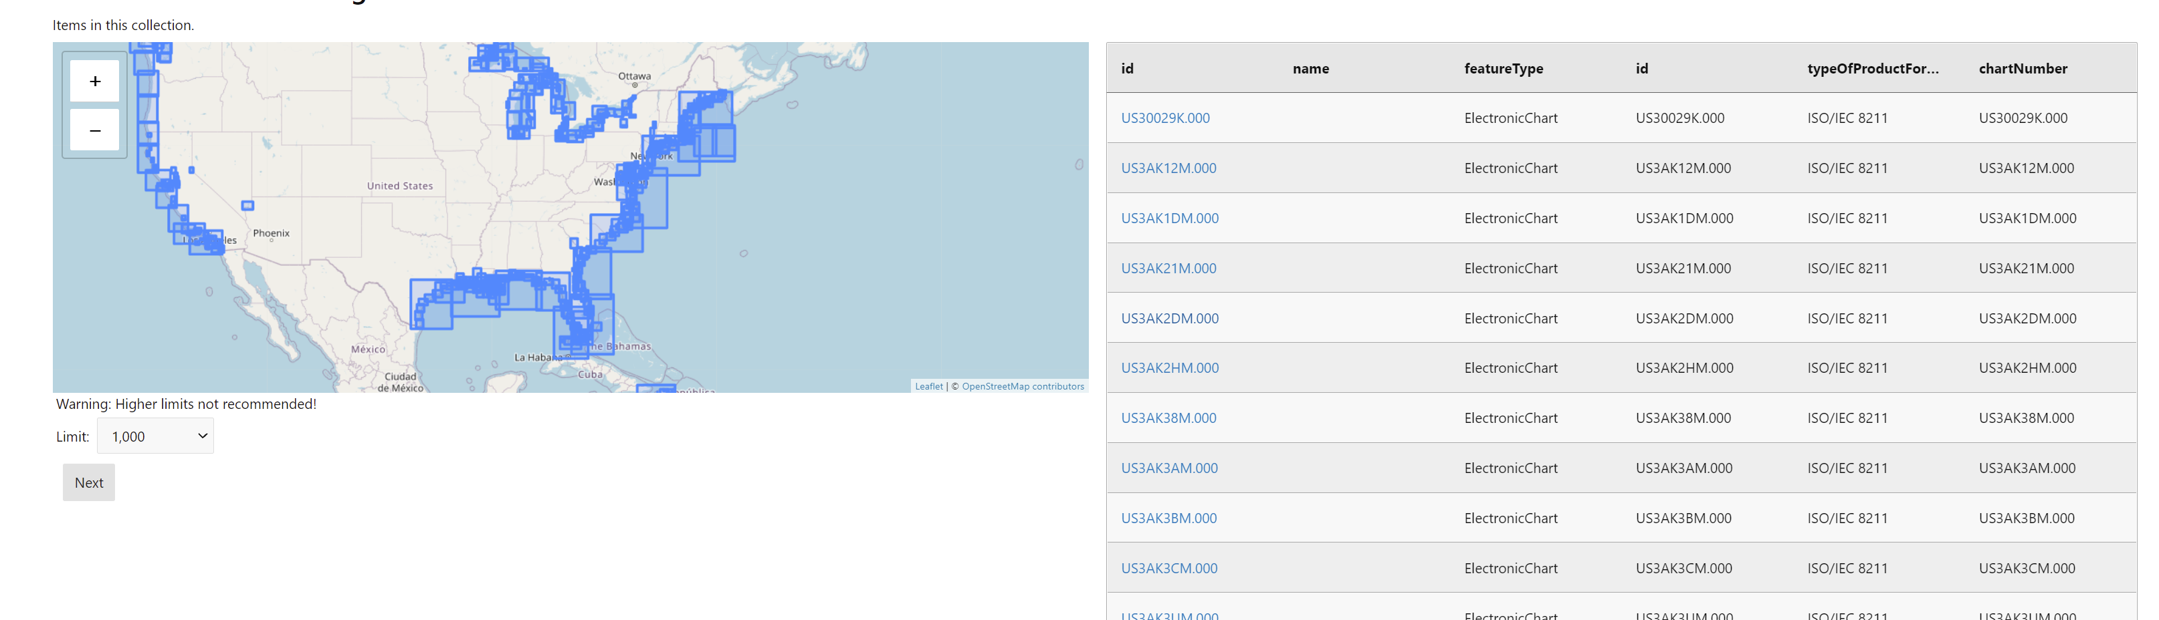
<?xml version="1.0" encoding="UTF-8" standalone="yes"?> <S128:Dataset xmlns:xsi="http://www.w3.org/2001/XMLSchema-instance" xmlns:S-127="http://www.iho.int/S127/gml/cs0/1.0" xmlns:xlink="http://www.w3.org/1999/xlink" xmlns:S128="http://www.iho.int/S128/gml/1.0" xmlns:S-123="http://www.iho.int/S123/gml/cs0/1.0" xmlns:S123="http://www.iho.int/S123/gml/1.0" xmlns:S-128="http://www.iho.int/S128/gml/cs0/1.0" xmlns:gml="http://www.opengis.net/gml/3.2" xmlns:S127="http://www.iho.int/S127/gml/1.0" xmlns:ns10="http://www.iho.int/s100gml/1.0" xmlns:ns12="http://www.iho.int/s100gml/1.0+EXT" gml:id="ID000"> <gml:boundedBy xsi:nil="true"/> <DatasetIdentificationInformation> <ns10:encodingSpecification></ns10:encodingSpecification> <ns10:encodingSpecificationEdition></ns10:encodingSpecificationEdition> <ns10:productIdentifier></ns10:productIdentifier> <ns10:productEdition></ns10:productEdition> <ns10:applicationProfile></ns10:applicationProfile> <ns10:datasetFileIdentifier></ns10:datasetFileIdentifier> <ns10:datasetTitle></ns10:datasetTitle> <ns10:datasetReferenceDate>2021-01-01</ns10:datasetReferenceDate> <ns10:datasetLanguage>en</ns10:datasetLanguage> <ns10:datasetTopicCategory>oceans</ns10:datasetTopicCategory> </DatasetIdentificationInformation> <member> <S128:ElectronicChart gml:id="US30029K.000"> <gml:boundedBy xsi:nil="true"/> <copyright>not applicable</copyright> <productType>ENC</productType> <issueDate>2013-09-26</issueDate> <updateNumber>0</updateNumber> <editionDate>2019-04-05</editionDate> <editionNumber>1</editionNumber> <chartNumber>US30029K.000</chartNumber> <compilationScale>45000</compilationScale> <specificUsage>approach</specificUsage> <producerCode>US</producerCode> <typeOfProductFormat>ISO/IEC 8211</typeOfProductFormat> </S128:ElectronicChart> </member>

Slide 7
Use Cases…
Data Providers
Make existing services searchable
Broader Use cases
Profiled datasets
Interoperability for third parties.
Multi-lingual
Others
Regulators
Regional / inter-agency
End users
Spatial Query (intersect with point, curve and surface)
Include large regions
Compilation scale (+usage?) + overlaps and selection
One or more Vertical datums
Feature inclusions
Query by producers, distributor
Commercial (e.g pricing)
Keyword (title?)
Product “purpose”

Slide 8
Plan of Action
Phase 1
Assessment of IHO Standards
S-128
S-100 Metadata Part 4a + dataset discovery metadata
Encodings, Schemas and Examples (simple?)
OGC Standards
API Features
API Records
Architecture
Reference Architectures
Examples
“Search”…
Phase 2
Implementation
Initial, simple using existing framework
S-100 specific implementation – Create or Adapt?
Technical Bottlenecks
OGC vs IHO GFM
Catalogues and Catalogues of Catalogues
IHO 19115 implementation
Mappings – types, date/times
Information Types
Relationships
Multi-Lingual
Implementation
Regions
US (data is free)
We can probably get UK, ROK, possibly DK, CA ask others
Formats – can ingest from ENC, also bespoke filters from IHO standard metadata can be written (existing and S-100 CATALOG.XML/CATALOG.031 and PRODUCTS.TXT)
“Search” and UI
What is the “best” way to test the project outputs and show users what has been developed?
Test…
ECDIS
User catalogues
Complex queries
Overlap Reporting and substitution
Outputs
IHO, Schemas and Product Specs (S-100 Main Document for edition 5.0.0 Early 2022), S-128 (for S-100 ECDIS, S-100 Governance Document)
OGC – outputs through MDWG for consideration of broader interoperability between IHO and OGC
Reference implementation for types and mappings of GFM

Slide 9
